Slide 1
ELLA
1 Svc Bn
MCpl Dhaliwal
(EO Tech)
Cpl Hollmann
(Veh Tech)
Pte Boychuk
(EO Tech)
Pte
Toker
(Veh Tech)

Slide 2
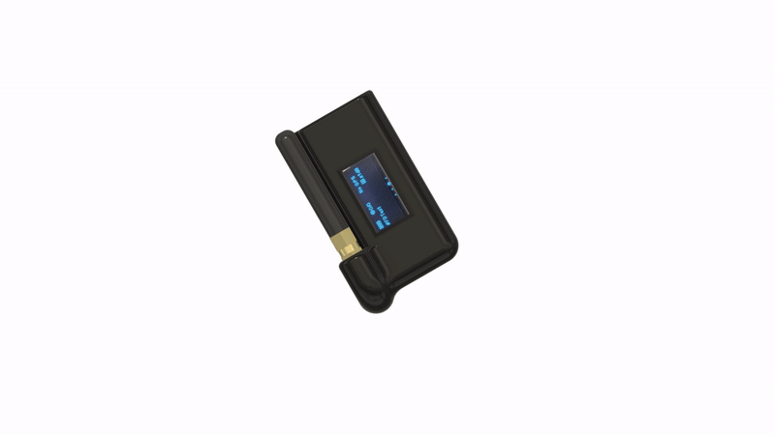
Local TAK
C o m m u n i c a t i o n s

Slide 3
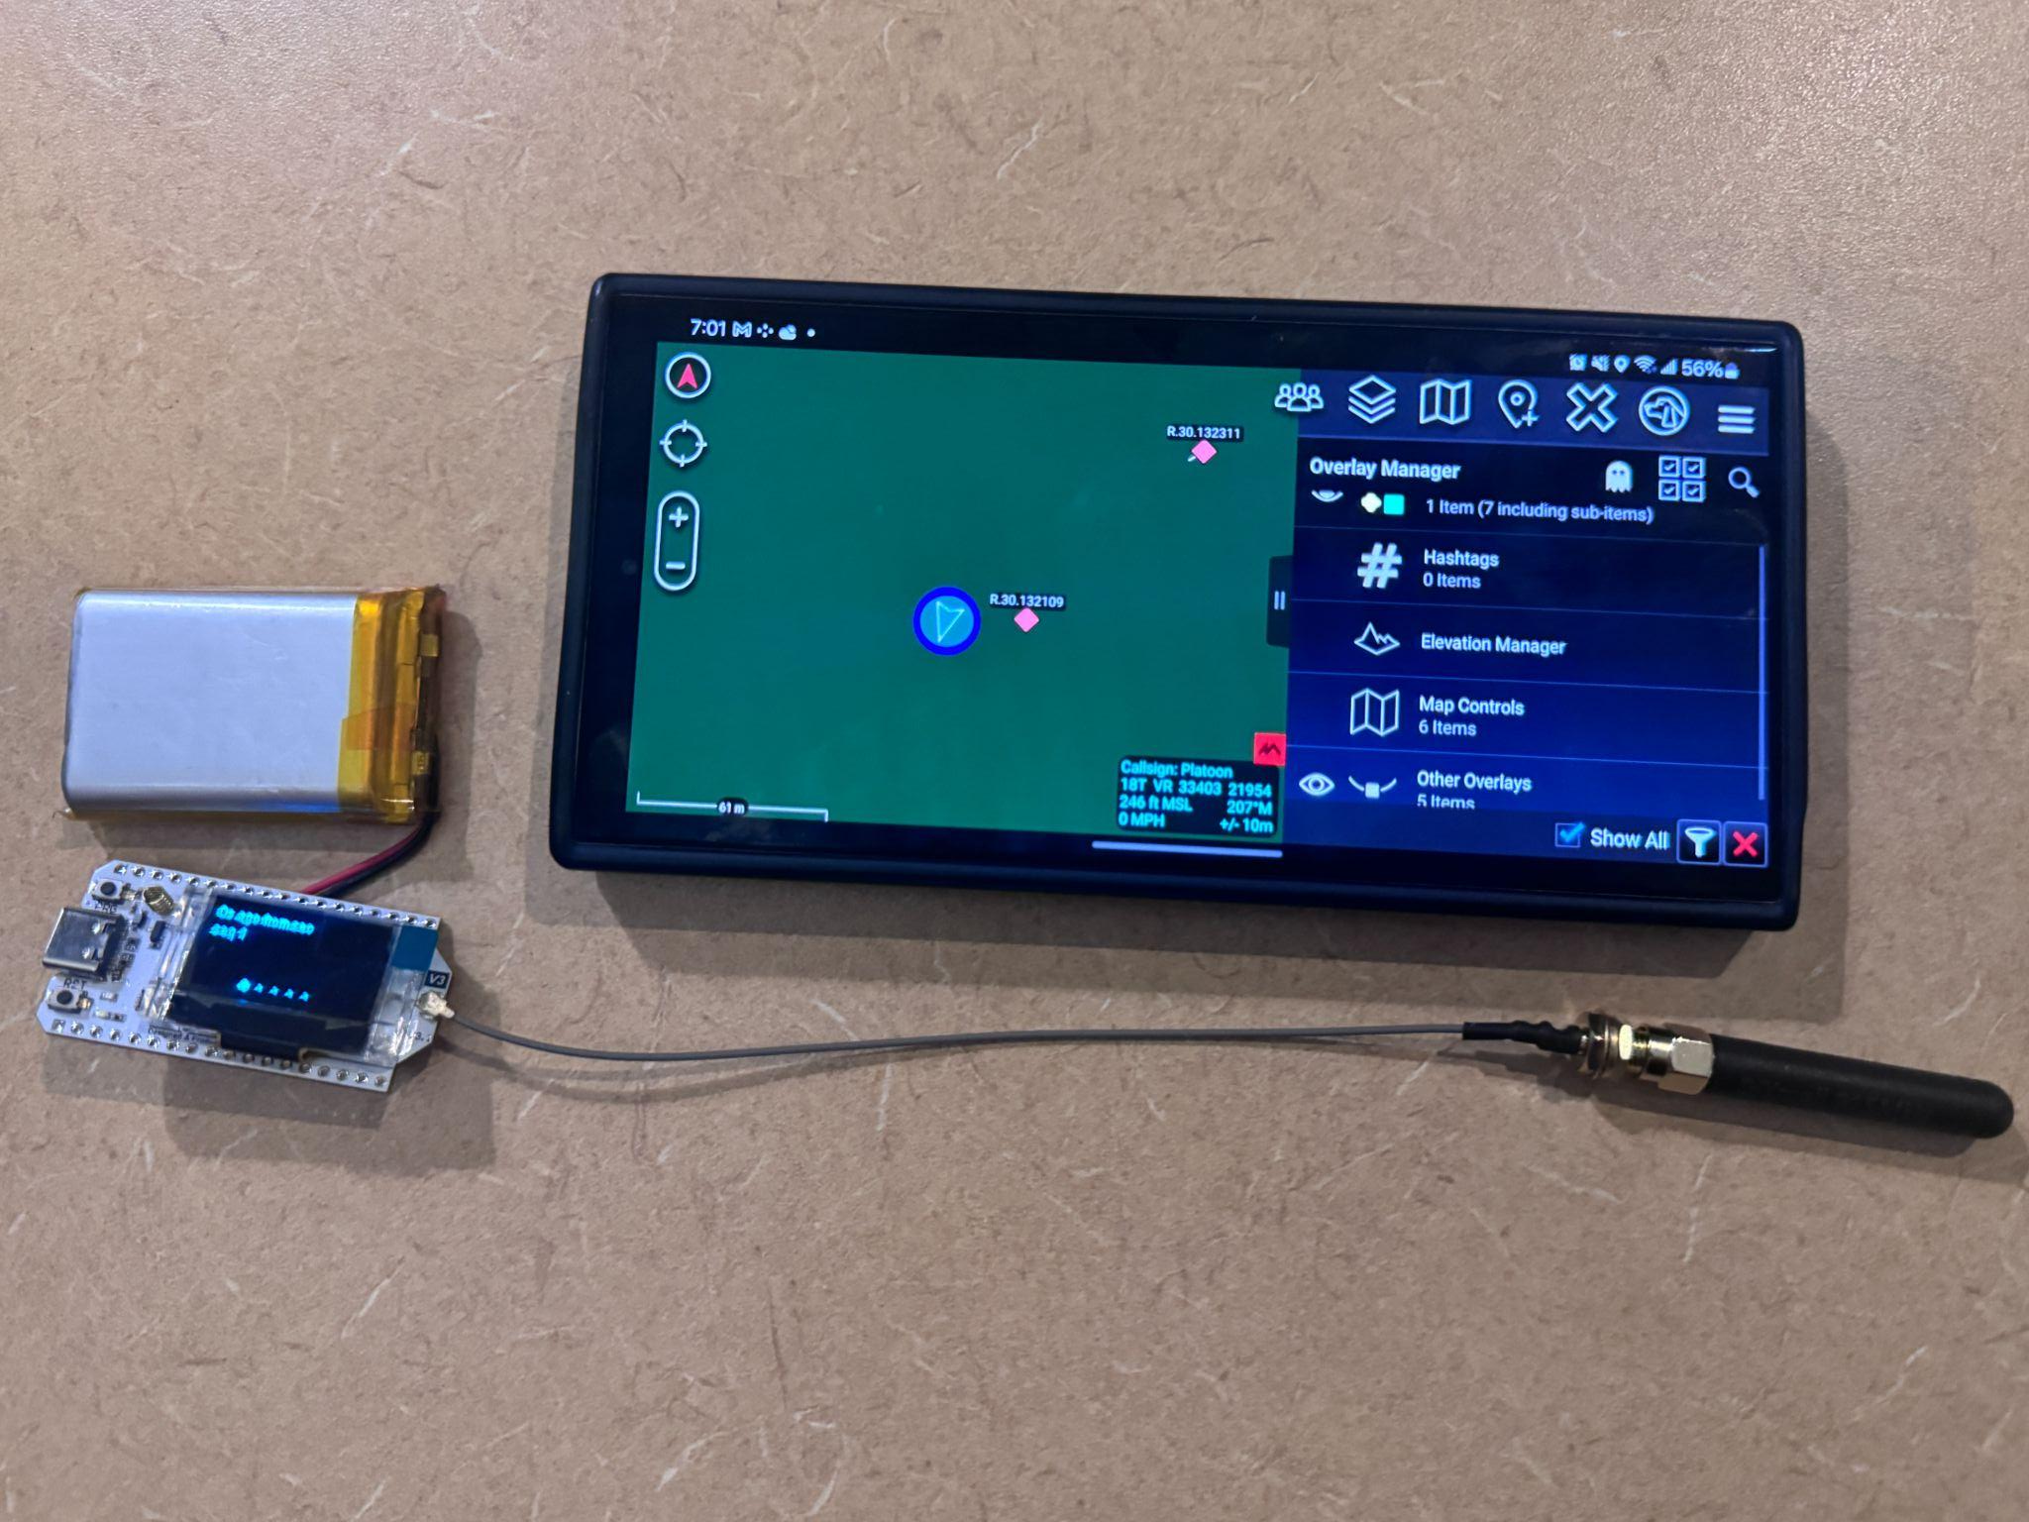
Local TAK
Local TAK is a offline first network designed to enable TAK networking at the section level
It achieves this through the use of mesh networking, allowing information to be transmitted peer-to-peer.
Prototype Hardware: ~$50 CAD
LoRa 32 Micro-Controller
1800 mAH Battery
3D Printed Case
Antennae
Software:
Meshtastic
CloudTAK and ATAK
Ranges:
~ 800m with concrete and metal walls
+40km with no obstructions

Slide 4
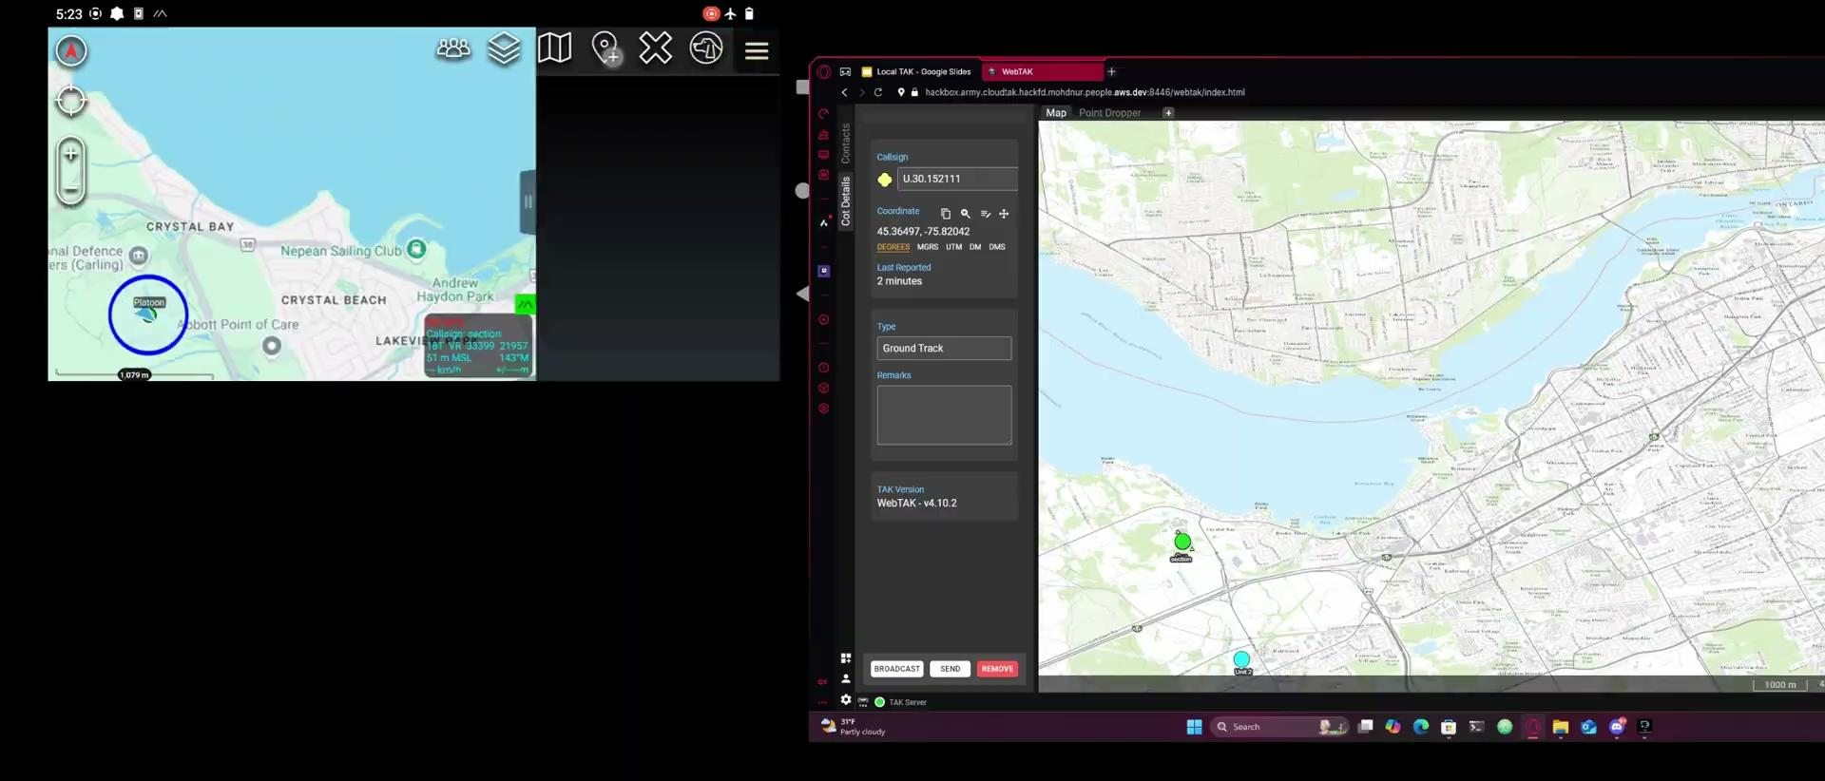
DEMO VIDEO
REMOTE
BRIDGE
HQ

Slide 5
Uses
Local TAK will allow members at a section level to access CloudTAK in environments where internet connectivity is limited.
This enables them to transmit/receive information to ensure maximum situational awareness in remote and austere conditions.
Fields that would benefit from the deployment of Local TAK:
Maintenance
Medical Services
Logistics
Combat Arms (Both mounted and dismount)

Slide 6

HOW DOES A MESH NETWORK WORK?

Slide 7
COMMUNICATION OUTLINE
Company
Platoon
Platoon
Section
Section
Section
Section

Slide 8

PL LEVEL VISUALIZATION

Slide 9
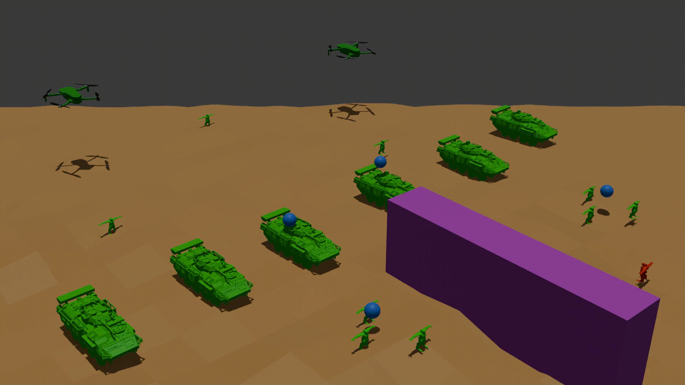
COY LEVEL VISUALIZATION

Slide 10
Roadmap
Further improve physical hardware
Increase file transfer capabilities
Ability to track heart rate/vitals
Develop a unified device to handle radio and TAK communications
Install higher power radio hubs into vehicles
Integrate TAK Chat with cloud based AI

Slide 11
SUMMARY
QUESTIONS?
The Local TAK system uses local radio mesh networks with a plug-and-play setup for quick deployment and minimal technical training. It ensures communication in remote areas with unreliable internet by using mesh networking, and can sync with broader military networks when online. This improves command and control, supporting both local and extended networks for operational continuity. Costing about $50 CAD per soldier, it tracks equipment and personnel data for tactical communications, enabling section-level communication especially without internet.
Local TAK

